Slide 1
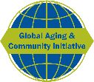
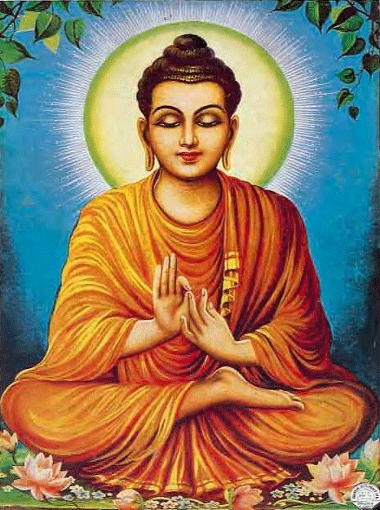
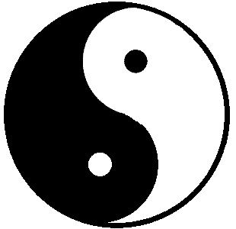


Spirituality, religiosity, and health in global perspective
Zachary Zimmer (Mount Saint Vincent University)
Presentation to the College of Population Studies, Chulalongkorn University, Bangkok, Thailand. December 19, 2016
Funded by John Templeton Foundation Grant # 5751 “Liking spirituality and religiosity to life and health expectancy: A global comparative study.”

Slide 2
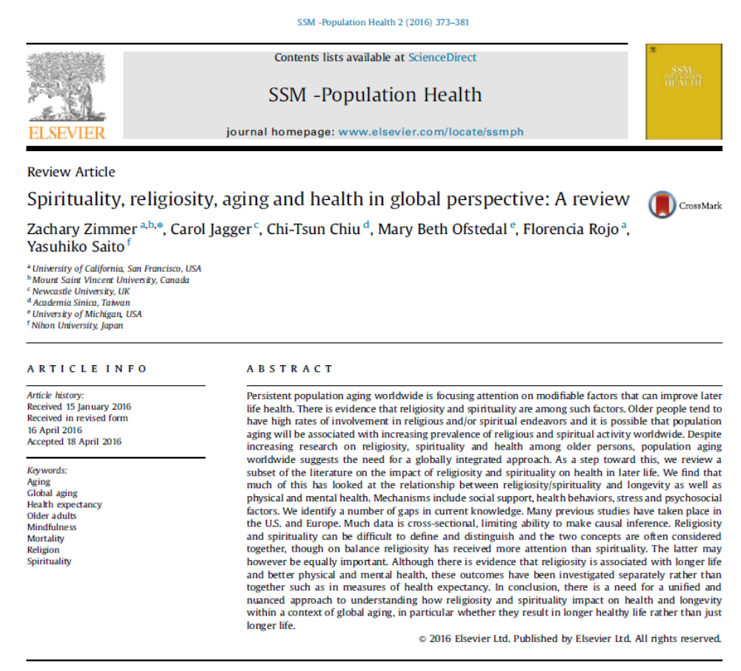

Slide 3

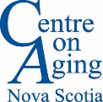
Global ‘Population aging’
‘Population aging’ is ‘growth’ in the older segment of a population
‘Population aging’ is occurring throughout the world
0 to 14
60 +

Slide 4
Reason 1: Drop in fertility
When fertility declines, ‘older’ generations are large relative to ‘younger’.

Slide 5
Reason 2: Chance of living to old age increasing

Slide 6
Old people are more likely to live to advanced ages

Slide 7
Number of Thais over 80 and under 5

Slide 8
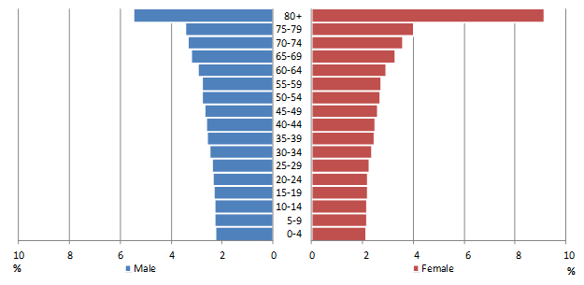
These combined forces have quite extreme effects on population composition
Japan 2050

Slide 9
Summarizing the demographics
Globally, the population is aging and old people are living to ever advanced ages.
This is a function of:
  Fertility decline
  Greater likelihood of surviving to old age
  Once old, good chance of living to a very old age

Slide 10
What is the impact of population aging and increasing longevity on quality of life and costs of care?
* Demographically, the impact depends on:
* Whether extra years of life are lived healthy or unhealthy
* Compression versus expansion of morbidity
* Heterogeneous compression
Idea that compression is occurring for subsets of the population

Slide 11
Where does religion factor in?
* Based on past evidence, religion may be one characteristic influencing heterogeneous compression
* Research in the U.S. has indicated religious people live longer and healthier lives than others
* Mechanisms
- Support
- Behaviors
- Stress
- Other psychosocial factors
- Selectivity
- Reverse causality
* Religion has some negative effects on health
* People near the end of life may turn to religion for support and meaning

Slide 12
Older people tend to be more ‘religious’ than younger
*
*
*
*
*
*
*
*
* Older significantly different from younger
Note: Older = 60+ Younger = 18-39

Slide 13
Our project is addressing some unanswered questions
Does religion associate with ‘healthy’ life expectancy?
‘Healthy’ life expectancy is number of years people in a population live on average in a healthy state.
Combines mortality and morbidity.
Can help us to determine if religion is influencing quality in addition to quantity of life.

Slide 14
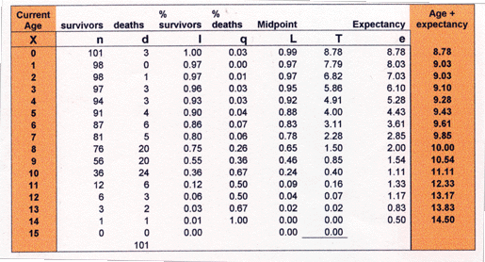
Models for calculating healthy life expectancy
1. Prevalence models (e.g., Sullivan Method)
2. Multistate life table models (e.g., IMaCh or SPACE)
P1
P2
P3
Healthy
Unhealthy
P4
P5
P6
Deceased

Slide 15
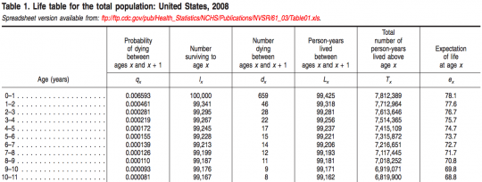
Minimum data requirements
1. Prevalence models (e.g., Sullivan Method)
2. Multistate life table models
Cross-sectional data
Age and sex specific health prevalence - not so easy to incorporate religion
+
Longitudinal panel data
Baseline (T1)
Follow-up (T2)
Health
Survival status
Age and sex
Health
Religiosity
Other covariates

Slide 16
Another unanswered question
2) How universal is the association between religion and health?
The universality is very uncertain.
Examples:
Do associations exist across religious expressions, norms, geo-political circumstances and epidemiological histories?
Do associations differ across public and private expressions?

Slide 17
Study name | Countries
Health and Retirement Study (HRS) | USA
English Longitudinal Study on Aging (ELSA) | England
Study of Health and Aging in Europe (SHARE) | 19 European
Mexican Health and Aging Study (MHAS) | Mexico
The Irish Longitudinal Study on Ageing (TILDA) | Ireland
WHO Study on Global Ageing and Adult Health (SAGE) | 6 Global
Panel on Health and Aging of Singaporean Elderly Survey (PHASE) | Singapore
Survey of Aged in Kerala (KERALA) | India
Costa Rican Longevity and Healthy Aging Study (CRELES) | Costa Rica
Chinese Longitudinal Healthy Longevity Study (CLHLS) | China
Korean Longitudinal Study of Aging (KLOSA) | South Korea
Taiwan Longitudinal Study on Aging (TLSA) | Taiwan
World Values Survey (WVS) | 94 Global
European Values Study (EVS) | 47 European

Slide 18
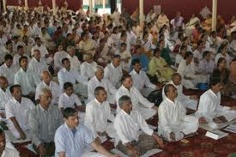
Disability-free expectancy by
‘public’ religious expression in Taiwan
MEN
WOMEN
Mira Hidajat, Zachary Zimmer, Yasuhiko Saito and Hui-Sheng Lin. 2013. Religious engagement, life expectancy and disability-free life expectancy in Taiwan. European Journal of Ageing. 10(3): 229-236.

Slide 19
Adding the ‘unaffiliated’
MEN
WOMEN
Mira Hidajat, Zachary Zimmer, Yasuhiko Saito and Hui-Sheng Lin. 2013. Religious engagement, life expectancy and disability-free life expectancy in Taiwan. European Journal of Ageing. 10(3): 229-236.

Slide 20

Disability-free expectancy by
‘private’ religious expression in Taiwan
MEN
WOMEN
Mira Hidajat, Zachary Zimmer, Yasuhiko Saito and Hui-Sheng Lin. 2013. Religious engagement, life expectancy and disability-free life expectancy in Taiwan. European Journal of Ageing. 10(3): 229-236.

Slide 21
Adding the ‘unaffiliated’
MEN
WOMEN
Mira Hidajat, Zachary Zimmer, Yasuhiko Saito and Hui-Sheng Lin. 2013. Religious engagement, life expectancy and disability-free life expectancy in Taiwan. European Journal of Ageing. 10(3): 229-236.

Slide 23
One hypothesis
Though the fundamental relationship between religious participation and health is positive the magnitude is stronger within national contexts that offer tolerance and choice in whether and which religious practice to pursue and how often to participate.
Proxies for tolerance and choice:
Human Development Index
Religious homogeneity
Current or former communist regime

Slide 24
Multi-level model of religious attendance and self-assessed health
4 components:
Individual-level effects, e.g., religious attendance
Country-level effect, e.g., religious homogeneity
Cross-level interaction,
e.g., religious attendance X religious homogeneity
4. Random effect, that is, idiosyncratic effect specific to each country not explained by the first three effects

Slide 25
Quick results summary
What associates with self-assessed health?*
 | Model 1 | Model 2
1. Individual effects
Religious participation (RP) | +ve | +ve
2. Country effects
Human development index (HDI) |  | +ve
Religious homogeneity (RH) |  | -ve
Communist system of governance (CG) |  | -ve
3. Cross-level interactions
RP X HDI |  | Not significant
RP X RH |  | -ve
RP X CG |  | -ve
4. Random slope | .0075*** | .0056***
*Models control for age and sex.

Slide 27
More unanswered questions
3) What about non-religious expressions of spirituality?
Religion is complex.
Distinguishing between religiosity and spirituality is difficult in a single culture let alone cross-nationally.
Religion – “specific principals organized around specific systems of beliefs, practices and rituals.”
Spirituality – “a notion of things sacred and transcendent.”
Religious person likely to define themselves as spiritual.
A spiritual person not as likely to define themselves as religious.

Slide 28

* Spiritual significantly different from religious
Note: Spiritual based on question about thinking about meaning of life

Slide 29
Second last slide
* My study aims to provide a broad examination of how religiosity and spirituality link with health expectancy in the context of global population aging.
https://globalagingandcommunity.com/
https://globalagingandcommunity.com/religion-and-health-expectancy/

Slide 30
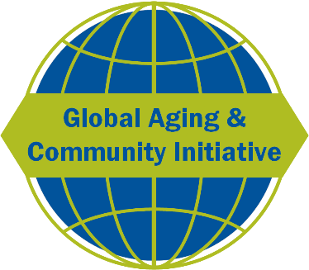
Thank you

